Slide 1

digital portfolio
STUDENT NAME: S.Jeeveshvar
REGISTER NO AND NMID: 24H216,28B2C82A2960EC4B06C463DCCFB02ECE
DEPARTMENT: BCA-”C”
COLLEGE: COLLEGE/ UNIVERSITY: AM JAIN COLLEGE, UNIVERSITY OF MADRAS

Slide 2


PROJECT TITLE
t
jeevesh - personal portfolio websitet

Slide 3
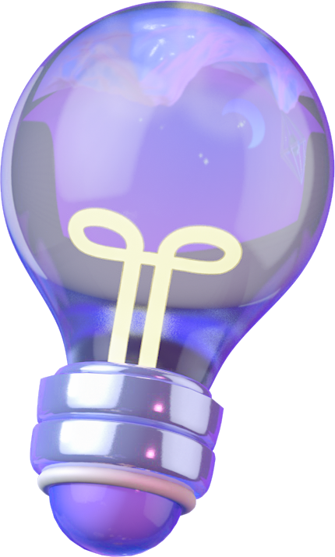
PROBLEM STATEMENT
In today’s digital-first world, professionals require a strong online presence to showcase their skills, projects, and achievements. A resume or LinkedIn profile alone is not enough to reflect creativity and individuality. The challenge is to design a modern, visually engaging, and responsive portfolio website that highlights technical skills, projects, and contact details in a professional yet unique style.t

Slide 4

PROJECT STATEMENT
This project is a cyberpunk-inspired personal portfolio website developed using HTML, CSS, and JavaScript.
The design reflects speed and precision (inspired by Formula 1 racing), while maintaining a user-friendly interface for visitors.
It showcases the following:
Introduction (hero section)
About Me with skills
Projects with live links
Contact form with validation
Social media links
Responsive design for all devices

Slide 5

END USERS
Recruiters / Employers: To quickly assess skills and projects.
Clients: To explore design and development capabilities.
Peers / Collaborators: For networking and collaboration opportunities.
General Audience: To know more about the developer’s skills and work.

Slide 6
TOOLS AND TECHNOLOGIES
Frontend Languages:
HTML5
CSS3 (Neon & Cyberpunk styling, animations, responsive design)
JavaScript (form validation, smooth scrolling, hamburger menu, scroll animations)
Libraries & Assets:
Google Fonts (Orbitron, Rajdhani)
Font Awesome (icons)
Deployment: Can be hosted on GitHub Pages, Netlify, or Vercel.

Slide 7
Portfolio Design and Layout
Theme: Dark neon cyberpunk theme with gradients and glowing effects.
Sections:
Header & Navigation – Sticky, responsive with hamburger menu.
Hero Section – Animated car racing track, large intro text.
About Section – Skills, personal details, image.
Projects Section – Grid-based cards showcasing work with links.
Contact Section – Contact form with validation + info.
Footer – Social media icons and copyright.
Responsive Design: Adjusts for desktop, tablet, and mobile.

Slide 8
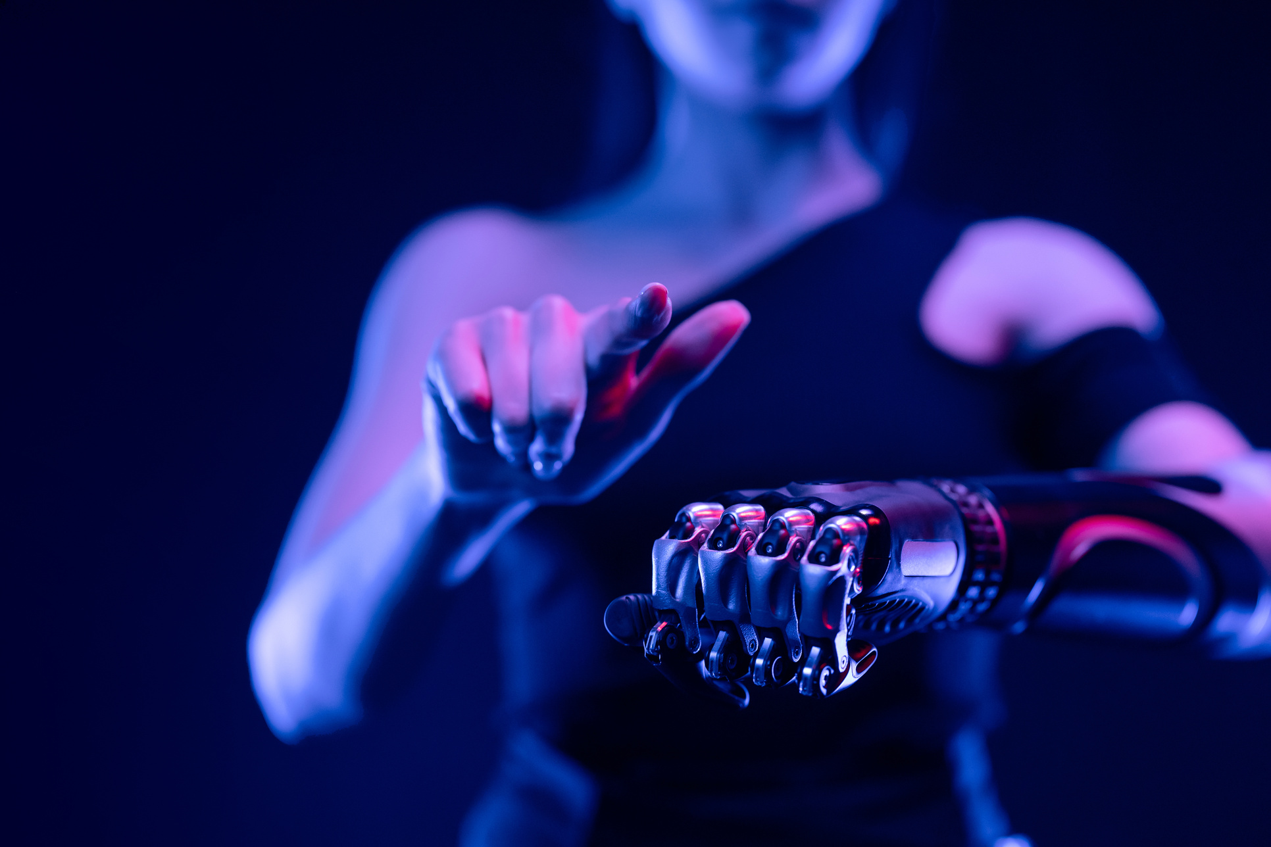
FEATURES AND FUNCTIONALITY
Smooth scrolling for navigation links
✅ Animated track & F1 car in hero section
✅ Interactive navigation menu (hamburger for mobile)
✅ Responsive grid layout for projects
✅ Contact form validation (name, email, message)
✅ Scroll-to-top button
✅ Social media integration (GitHub, LinkedIn, Instagram, Twitter)
✅ Hover effects & animations for buttons, links, and cards

Slide 9
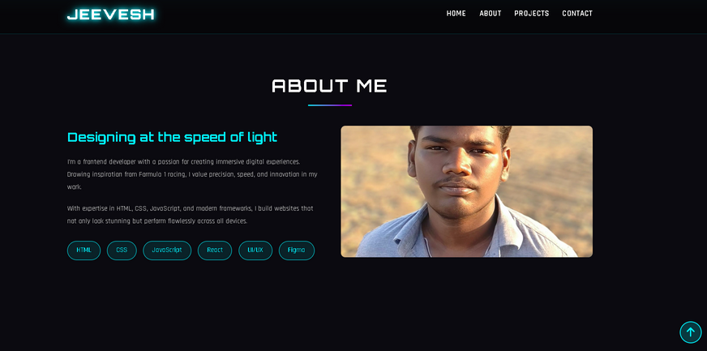
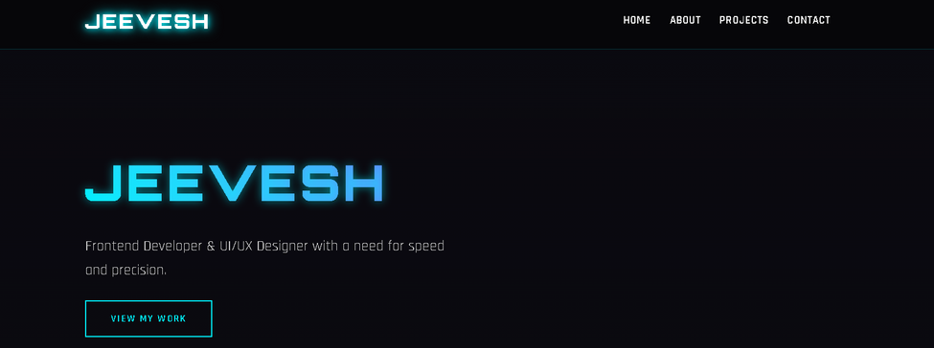
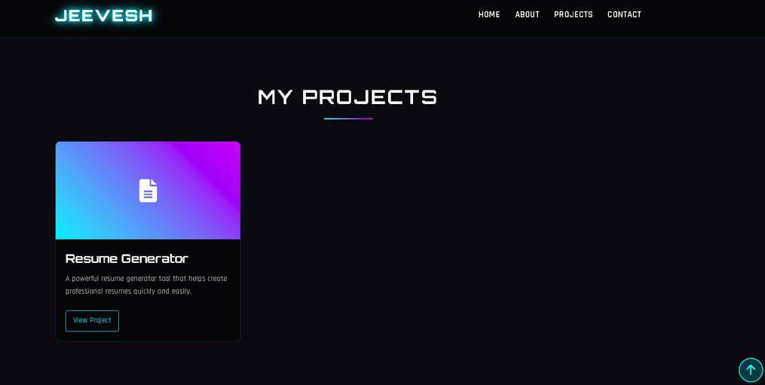
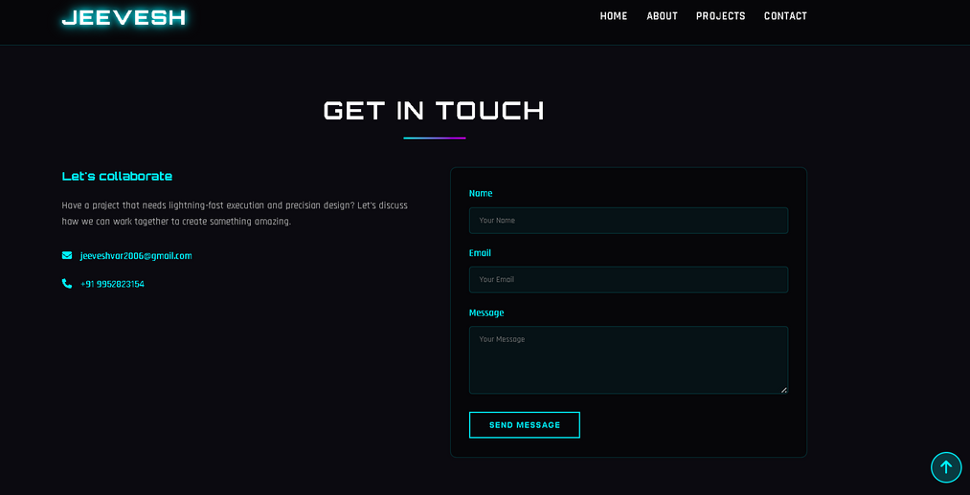
Results and Screenshots
Result:
A professional, futuristic portfolio website that clearly demonstrates technical skills and design creativity while ensuring mobile compatibility.

Slide 10
Conclusion
The Jeevesh Portfolio Website successfully addresses the problem of showcasing skills and projects in an engaging way.
With its neon cyberpunk theme, responsive design, animations, and contact functionality, the portfolio stands out from traditional resumes and static websites.
This portfolio can now serve as a strong personal branding tool for job opportunities, freelancing, and networking.

Slide 11
GITHUB LINK
HTTPS://GITHUB.COM/24H216JEEVESH

Slide 12
THANK YOU!
FOR YOUR ATTENTION

